Slide 1
Rabbits and the Law
Trying to navigate the critical balance of where rabbits lie in the judicial system

Slide 2
Where do rabbits lie in current legislation?
The following acts and legislation provide protection for farmed rabbits in Nova Scotia;
Animal Health and Protection Act
Animal Protection Act
Meat Inspection Act/Regulations respecting Slaughter
All three are enforced by inspectors designated by the Minister of Agriculture.
Domesticated rabbits fall beneath the Animal Protection Act - The SPCA is governed within that act, but rabbits that are running at large, abandoned or loose are not caught or trapped by the SPCA.

Slide 3
Farmed, tested on and kept as pets
Rabbits are in an extremely vulnerable spot and have been for a great number of decades. From being farmed for their “meat” and in some instances and breeds, such as the Angora, for their fur and also widely used in various amounts of testing these small and gentile animals are some of the most abused in the world.
Rabbits are one of the most commonly used animals in research and testing, second only to guinea pigs. Although their numbers have declined over the past two decades, 205,482 rabbits were held in American laboratories in 2012. They are also frequently used in experiments that cause pain and suffering. Rabbits are widely used for experimentation and testing mainly due to practical, rather than scientific, considerations. They are small and usually docile, easily restrained, cheap to maintain and breed prodigiously. Rabbits are used in testing for cosmetic, personal and household products, for medical products such as vaccines, drugs, medical devices, developmental and embryotoxicity, biomedical research as models for diseases and disorders of the eyes, skin, heart, lungs, immune system, as well as asthma, cystic fibrosis, diabetes and much more. As if the suffering caused by these experiments weren’t enough - the laboratory environment itself is also an enormous stress on them.

Slide 4
Federal Code of Practice regarding the keeping of rabbits
The Federal Code of Practice set out by the National Farm Animal Care Council outlines how farmed animals are kept from birth, weaning, growth and eventual death.
The guidelines set out by them cover the aspects of the size of cages, flooring, ventilation, food, water, detecting illness and methods of euthanasia.
The alarming pattern in all of these “laws” and “legislation” is the crass and cold treatment of animals kept for food or farming. The recommended practices are chilling and clinical to read. This is the gold standard for the industry as well, and gold standard is rarely a standard any industry can live up to. Especially with very limited inspectors.

Slide 5
Provincial “Standards”
Inspections of farms are not done as frequently as they should or need to be. The system is a mostly complaint based process in between permit renewals.
This amplifies the issues for the rabbits at these farms. Unless the staff and management are very proactive and welfare based, rabbits could be suffering and it not ever be reported or investigated.
For domesticated rabbits who have next to no real legislation or protection, being abandoned is a very real and scary reality. We estimate the numbers of rabbits that have been “set lose” or “free” estimate well into a thousands. Domestic rabbits who are not altered are able to produce almost constantly making the numbers grow rapidly and the issue compound quickly. We are aware of large groups or colonies of domesticated rabbits that we are unable to trap and help as they are on private property and unless we have permission from the owner, we are unable to assist them or we would be trespassing.
There are no fines, or any repercussions to dumping these rabbits. No real deterrent to dumping them when they are no longer “cute”, “small”, become destructive or a child loses interest in them. The fate of domesticated rabbits that are dumped is extremely grim.

Slide 6
We need to make them a priority!
The upsetting and frustrating part to all of this is that these are DOMESTIC animals. Not much different than a domesticated cat. They have kits that are blind and hairless for almost two weeks. Unlike hares, they stay with their nest and that puts them and their entire litter at a grave risk. Like a sitting duck waiting to be injured or carried away, they face dangers on the ground such as cats, dogs, mink, foxes and humans just to mention a few. Along with the dangers from above from the birds of prey.
We only have snowshoe hares in nova Scotia - not domesticated rabbits. Hares are equipped to survive outside. They have the instinct and ability to sense danger, find food and survive. They have leverlets that are born sitting up ready to run if need be, eyes wide open and much more aware of their surroundings that has been imprinted from the mother hare. Hares feed at dawn, leave the nest for the day and return at dusk, leaving the babies in a high grass area that is safe.
And because of the lack of prosecution or fines they will continue to slip through the cracks and be dumped outside to fend for themselves -with people stating “they are just rabbits”

Slide 7
Why are some breeds farmed?
Breeds such as the Californian, New Zealand Whites, Rex and Palomino are the most common that are farmed for meat. These are large breeds that have a greater muscle mass and therefore can be more profitable.
Due to their quick gestation, between 30-34 days, and their high litter average, rabbits are a fast maturing species that due to their size are able to be kept in a much smaller area than another species such as cattle.
This high “yield” or large litter size makes them an ideal farming practice for a farm that has limited space. The National Farm Animal Council Code of practice states that a mature buck must have a minimum height of 45cm (1.47 ft) and all rabbits regardless of size a maximum height of 60 cm (1.97 ft) and a minimum floor space of 4.95 ft. This is not a large area to “live” out their short lives. Rabbits are able to breed starting as young as 3.5 to 4 months of age so the cycle continues from there again.

Slide 8
Who regulates and checks on farmed rabbits?
At the moment the Department of Environment’s Meat Inspectors are the ones who investigate any complaints regarding the care and welfare of farmed animals including farmed rabbits. There are a very limited amount of these inspectors - only 4 for the entire province. Sadly this limited workforce is unable to cover the vast and various amount of farms and abattoirs in Nova Scotia so many farms are not even visited on an annual basis.
The current standards laid out in the Meat Inspection Act for Nova Scotia are focused mostly on the operation of facilities that keep animals for food production. It outlines such things as; lighting, husbandry, personnel, signs of illness and disease and their end of life procedures.
Saldy - throughout all of this the fact that these are animals that feel pain, have complex emotions and relationships with one another, are viewed as commodities and there is a total disregard for their emotional well being. It is appalling that animals are still “property” under current Canadian law. They are owned like an inanimate object, not like the living being they deserve to be valued at.

Slide 9
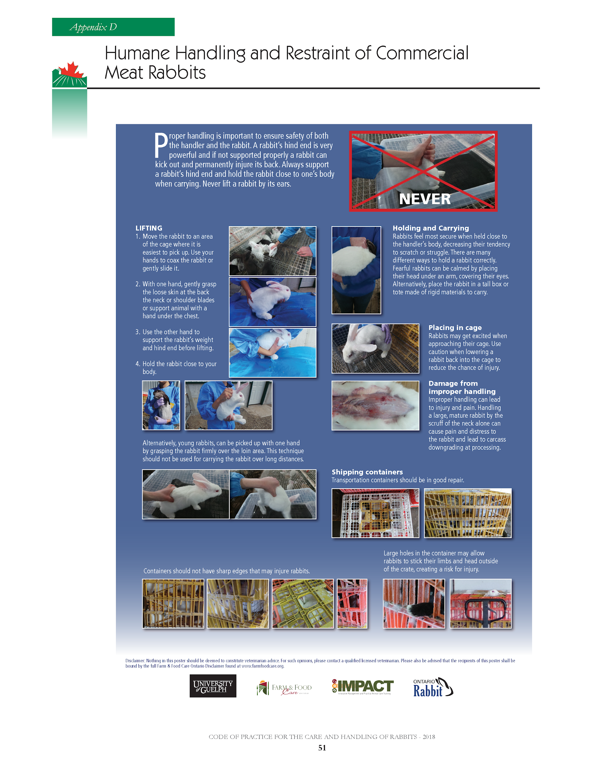

Slide 10
Who governs domestic rabbit abandonment?
When we met with the Agriculture Minister, Honorable Keith Colwell he stated that the SPCA is mandated to pick up abandoned domestic animals. We brought to light how this has not been the case with rabbits, and when we direct people who contact us to contact the SPCA, they are told they do not pick them up.
As far as animal control goes - they do not pick up domestic rabbits either, as they state they only deal with cats and dogs.
So here WE are. We supply traps, instruction and often times manpower to come and help trap and catch the abandoned rabbits that we are alerted to.
How are domestic rabbits any different than a Guinea Pig or parrot being abandoned outside? They are not equipped to deal with the hazards of being outside - they fall victim to predation, hit by vehicles, chased by dogs and humans. Outside is a very dangerous space.

Slide 11
Rabbits are the definition of
“A Grey Area”
The only real legislation they have is under a farm animal welfare legislation. Breeds that are kept for the production of their fur and meat are the same breeds that are kept as household pets. This crossover if you will, has them in a very grey and unprotected area. The Federal Code of Practice governs the way they are housed, grown, fed, cleaned and ultimately killed. These “standards” are quite shocking and appalling.
We are at a crisis level with the numbers of abandoned rabbits here in Nova Scotia and the numbers are growing each month! We need to take action on this growing issue for rabbits.
The NEED to have an enforceable law that would see them protected similar to the ways dogs and cats are legislated.
Why are they chosen to be abused so widely in so many facets? They are tested on for cosmetics, farmed for their flesh and fur, abandoned and dumped on a daily basis. Are they that unworthy of protection?

Slide 12
What can we do to help these amazing, loving and sentient little beings?
Be vocal! Make your voice heard for the voiceless. Having an understanding of the laws and how it pertains to rabbits will make you very well equipped to discuss their welfare and plight for protection. They need YOU to fight for them.
Discuss rabbit abandonment with as many people as you can. The more people who understand the need for legislation the more voices to add to the fight.
Support rabbit rescues and organizations that are fighting for education and change.
Remember:
“Never doubt that a small group of thoughtful, committed people can change the world. Indeed, it is the only thing that ever has” - Margaret Mead

Slide 13
Lack of empathy and understanding
We are in the same space we were in over 15 years ago with domesticated cats - it’s time for this to change for domesticated rabbits as well
Very vulnerable, and sentient creatures who deserve to have a safer, more enriching life free from unnecessary danger, cruelty and certain death.
We need to began to be more vocal and fight for some positive change for rabbits. Animals care and well being is now something that more are thankfully becoming involved in. It is our voice to help the voiceless.
Let’s prove to the rabbits that we care enough about them to make them a priority for some positive change in all aspects of their lives.

Slide 14
How can I take action??
Write an email expressing your concern regarding the horrible state of how rabbits are allowed to be kept and how they have very little, if any protection and legislation.
The Honorable Keith Colwell- Minister of Agriculture in Nova Scotia
902-424-4388 or by email: min_dag@novascotia.ca
Contact your local MLA - addresses and names can be found at Gov.ns.ca
Nova Scotia Environment Farm Animal Welfare - Ask to speak to an Inspector 1-800-877-936-8476 or email ICE@novascotia.ca
National Farm Animal Council https://www.nfacc.ca/contact-us
Nova Scotia Spca Provincial Office 902-835-4798

Slide 15
Always remember…..
“Compassion is the ultimate expression of your highest self” - Russell Simmons

Slide 16
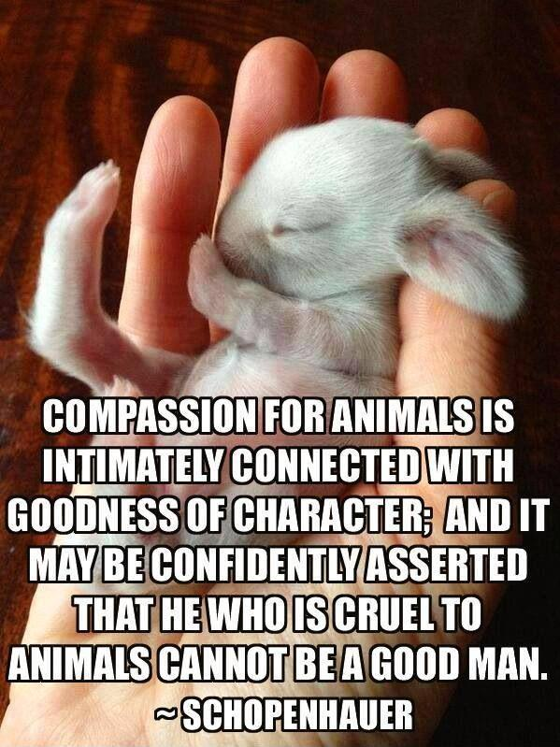
Thank you for caring - The rabbits need us!

Slide 17
References
National Farm Animal Council code of Practice: https://www.nfacc.ca/codes-of-practice/rabbits
Nova Scotia Meat Inspection Act: https://nslegislature.ca/sites/default/files/legc/statutes/meatinsp.htm
Animal Health Protection Act for Nova Scotia: https://nslegislature.ca/sites/default/files/legc/statutes/animalhe.htm
Animal Protection Act for Nova Scotia: https://nslegislature.ca/legc/bills/60th_2nd/3rd_read/b186.htm
American Anti-Vivisection Society: https://aavs.org/animals-science/animals-used/rabbits/
CFIA: http://www.inspection.gc.ca/animals/terrestrial-animals/humane-transport/provincial-and-territorial-legislation/eng/1358482954113/1358483058784

